Slide 1

IR-Based UAV Detection with Deep Learning for Monitoring No-Fly Zones
Shipra Chandra (20214090)
Sundram Mishra (20214020)
Shresth Sonkar (20214272)
Setu Dineshbhai Patel (20214157)
Under the guidance of Prof. Shailendra Shukla

Slide 2
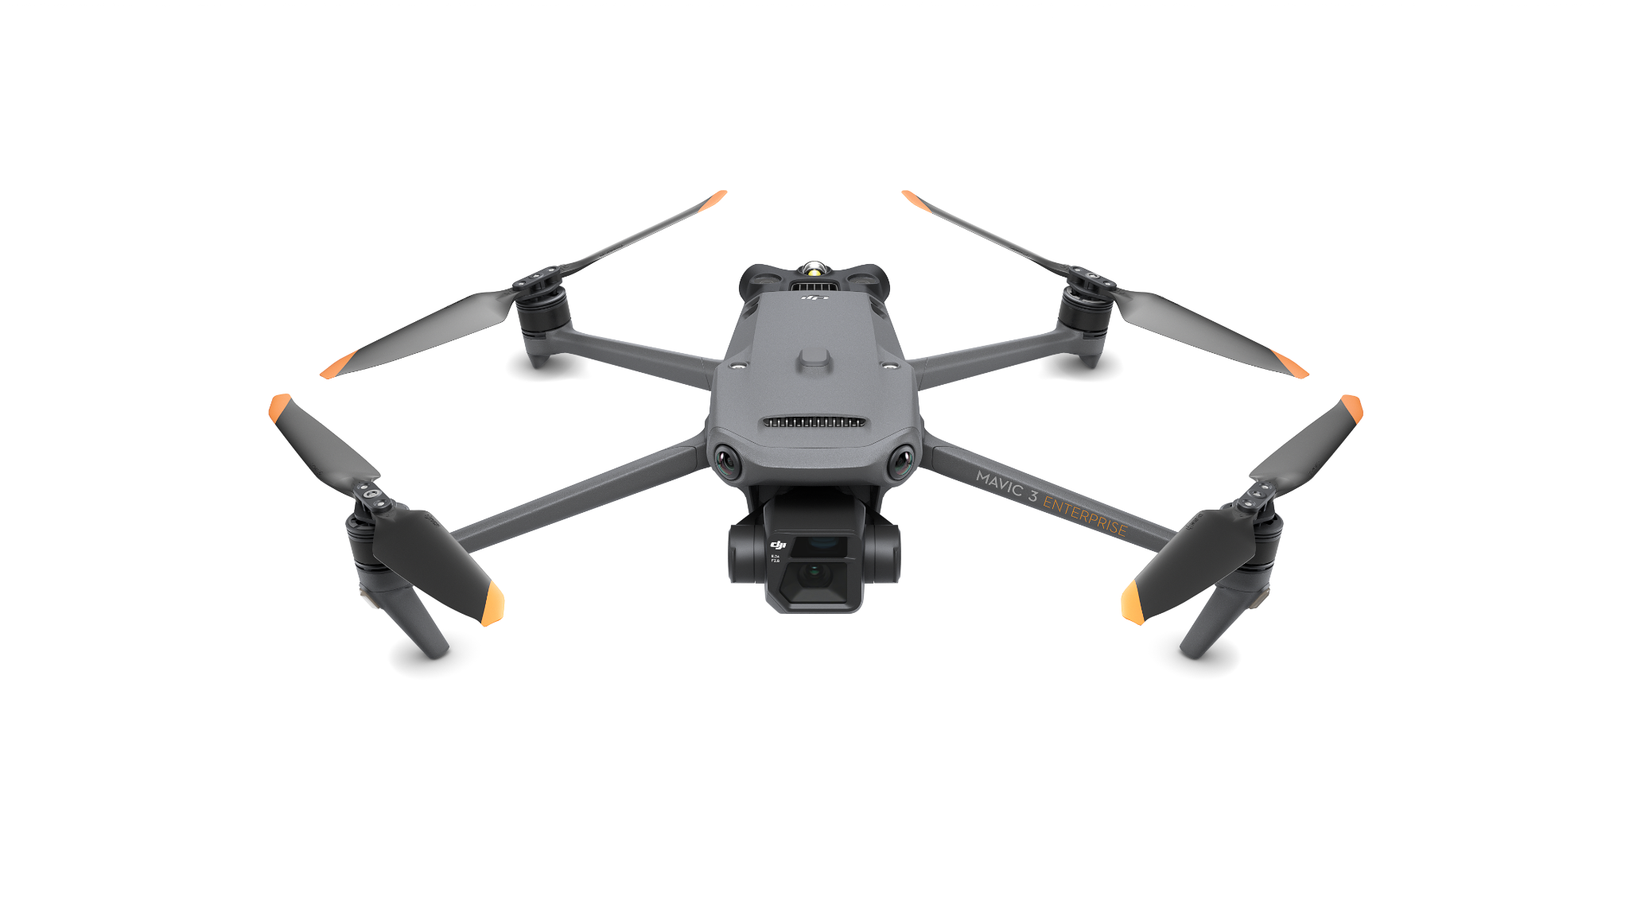
Introduction
The rapid adoption of drones in various domains, from recreational use to military applications, has brought both opportunities and challenges. Although drones offer remarkable benefits, their potential misuse has raised significant security concerns.
The issues include:
Privacy Invasion: Privacy of individuals is breached through ‘lock-on’ footage captured by drones mounted with cameras.
Hostile Utilization: Enemy formations can use drones as Surveillance devices to get crucial information.
Delivery Risk of Pay Loads: Drones can be used to deliver poisonous materials/snakes for the purpose of terror attacks.
Interference of Space: Uninvited Drones may bypass or interfere with the drones’ operators that are approved such as rescue units.

Slide 3
Background to Problem Statement
Invasive unmanned aerial vehicles (UAVs) make big public gatherings vulnerable, such as Maha Kumbh Mela celebrations held annually, which has the potential to attract millions of participants from various parts of India.
The issues include:
Privacy Invasion: Privacy of individuals is breached through ‘lock-on’ footage captured by drones mounted with cameras.
Hostile Utilization: Enemy formations can use drones as Surveillance devices to get crucial information.
Delivery Risk of Pay Loads: Drones can be used to deliver poisonous materials/snakes for the purpose of terror attacks.
Interference of Space: Uninvited Drones may bypass or interfere with the drones’ operators that are approved such as rescue units.
The safety of the airspace over large clusters of human beings for example the Maha Kumbh Mela is essential to ensure that catastrophes do not occur, privacy is maintained as well as the order.

Slide 4
Objective
This project aims to create an IR-based UAV detection system. Advanced image processing and machine learning techniques are utilized in the system.
Its key objectives are:
Correct Classification: Distinguish UAVs from birds or any other flying objects.
Real-time Alert: Notify security teams for immediate response.
High-Risk Event No-fly Zone Security: Secure no-go zones during high-risk events. This will maintain public safety.
IR-based detection, combined with AI-driven classification models, provides a scalable and cost-effective solution, especially for high-security events like the Maha Kumbh.

Slide 5
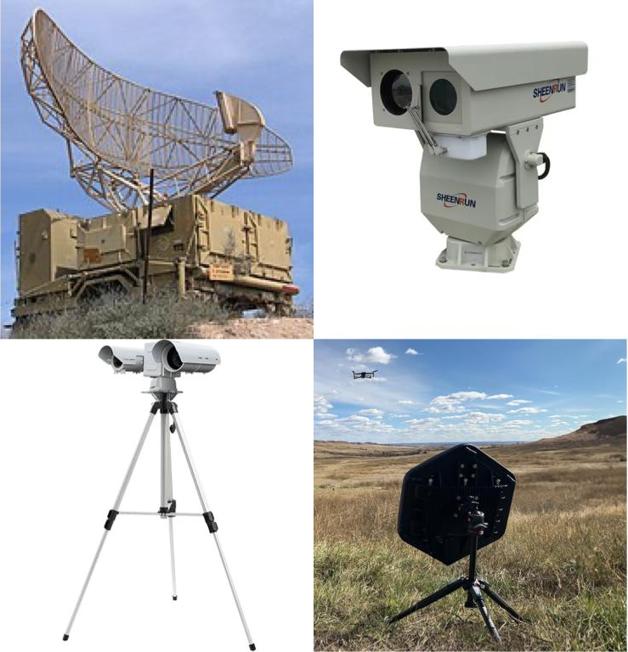
Overview of UAV Detection Methods
At different points in time, different approaches have been used for the UAV detection depending on the specific requirements and the operational environment.
Among these are :
Radar Systems
Visible Light Cameras
Acoustic Sensors
Infrared (IR) Cameras

Slide 6
Current Approaches
Most commonly used approach till now has been RADAR. Radar systems operate by emitting electromagnetic waves and analyzing the reflections from airborne objects. By measuring the time delay and Doppler shifts of these reflections, radar can determine the object’s distance, speed, and sometimes its size and shape.
Despite its popularity, RADAR has some major drawbacks as well :
Cost and Complexity: Radar systems require significant investment and complex deployment, making them impractical for temporary setups.
Small Radar Cross Section (RCS): Drones often have low RCS values due to their small size and non-metallic materials, making them difficult to detect. Birds and other objects can trigger false alarms as their radar signatures overlap with drones.
Unconventional Flight Patterns: Slow speeds and hovering positions create challenges for traditional radar systems.

Slide 7
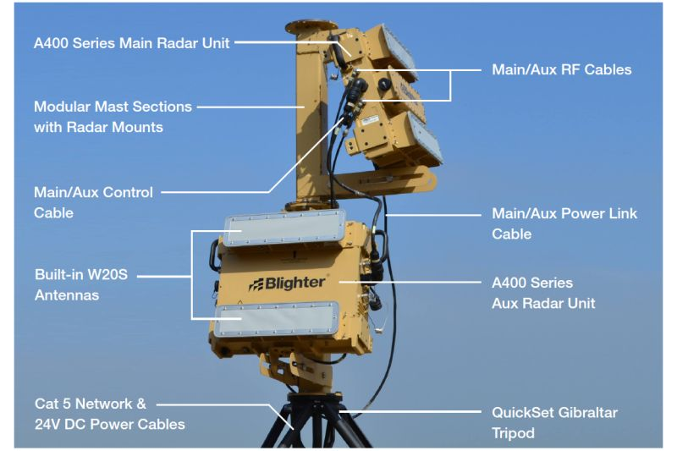
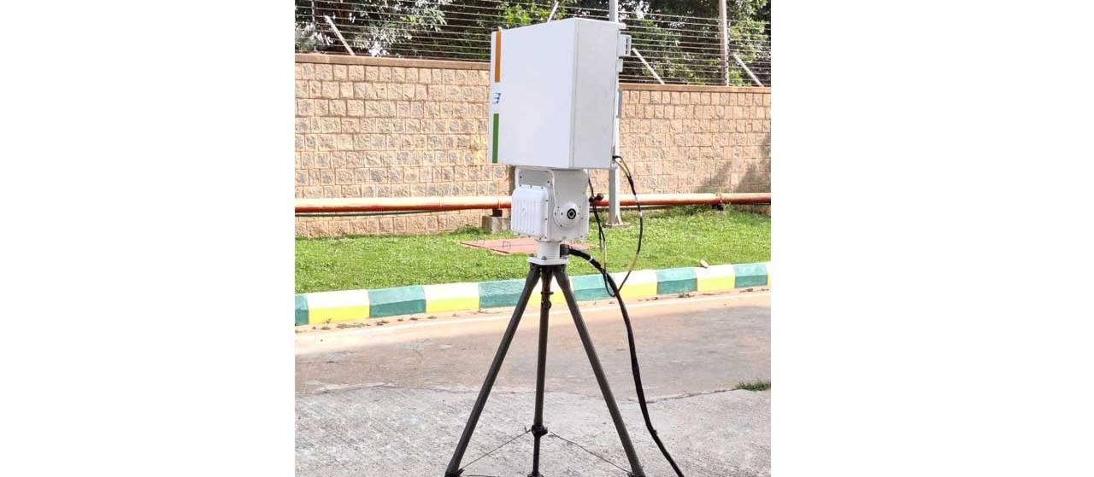
Examples of existing Systems
Blighter X400
Bharat Electronics DDR

Slide 8
Why Infrared Camera Based Detection
IR cameras are a breakthrough development in drone-detecting systems which other detection technologies are limited. IR Cameras have certain advantages over all other technologies:
Cost-Effective Deployment: Compact and scalable for temporary installations like those required at the Maha Kumbh Mela.
Construction Material Lattice: They don’t care what the construction material is, be it metallic, or non-metallic, they detect UAVs.
Reduced False Positives: Precisely distinguishes UAVs from birds or other objects based on their heat signatures.
Light Weight: This makes them great for temporary security arrangements for example at the Maha Kumbh Mela as they combine lightweight design and low cost.

Slide 9
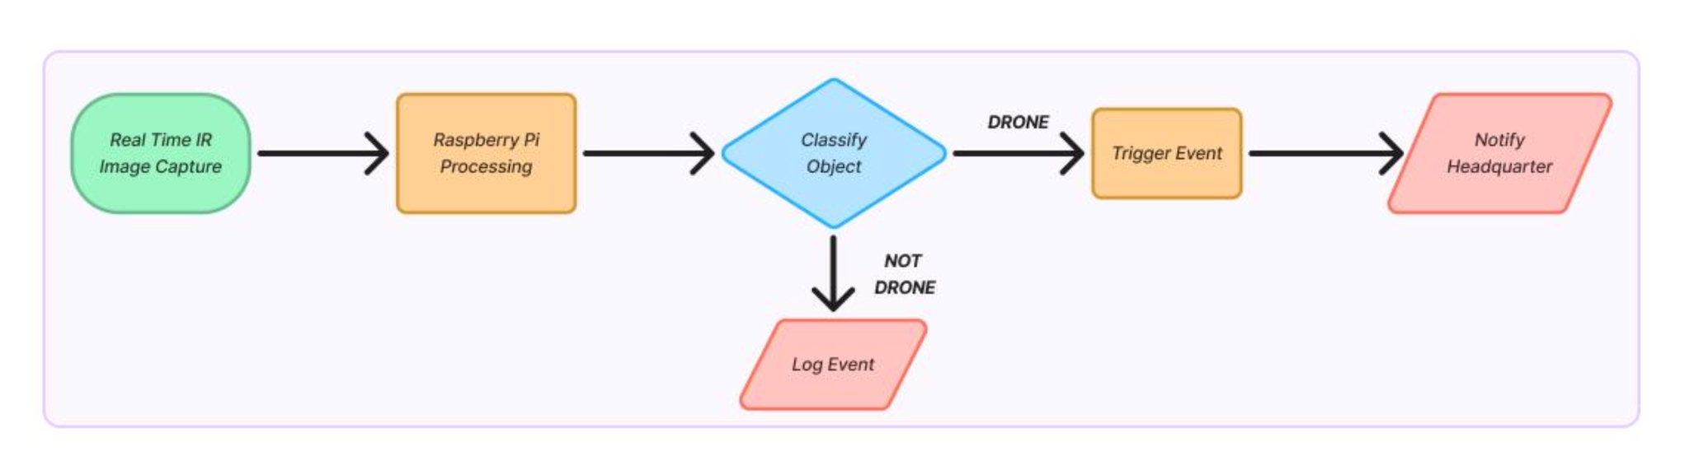
Overview of the Model

Slide 10
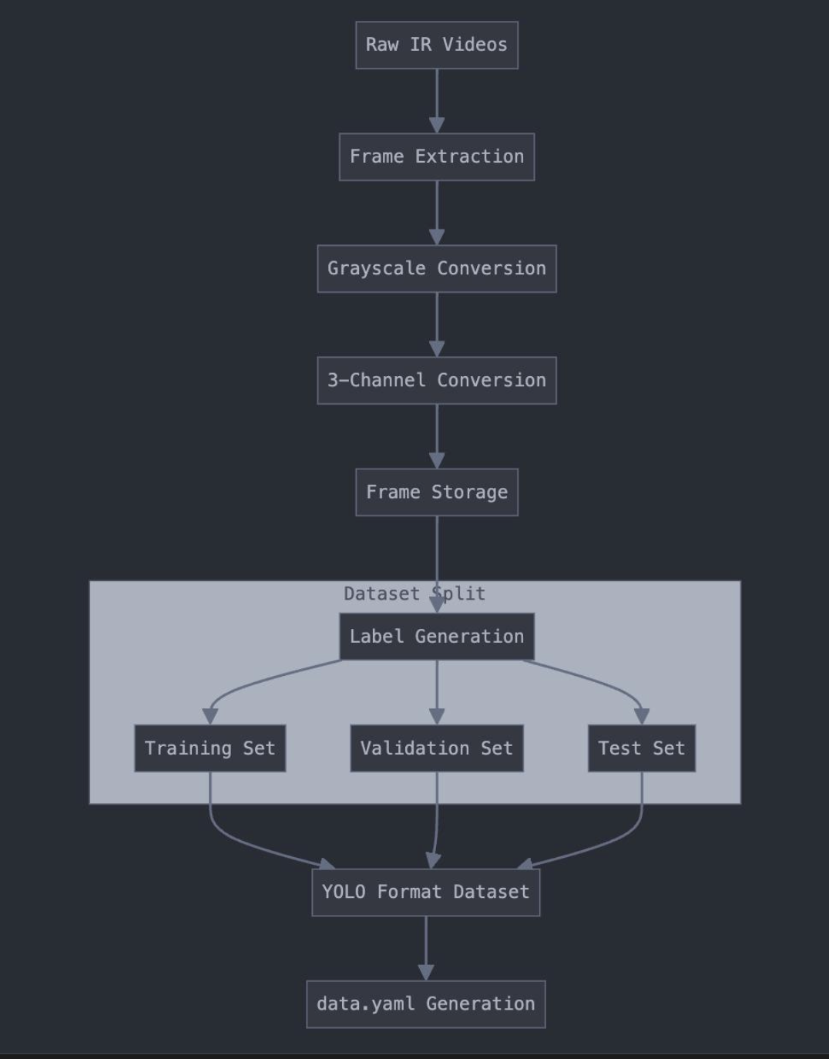
ML Model

Slide 11
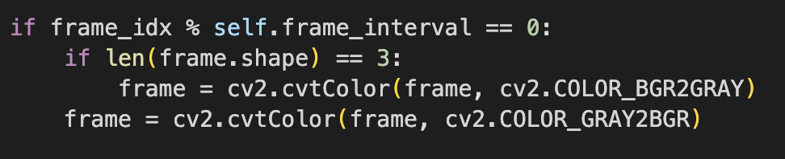
Data Preprocessing
Using infrared (IR) imaging, edge computing capabilities, and deep learning models, the system ensures high accuracy and reliability in monitoring airspace, particularly in restricted or no-fly zones.
Dataset Preparation :
Frame Extraction:
Frames are extracted from videos every 5th frame to reduce redundancy.
Frames are converted to grayscale and normalized.

Slide 12
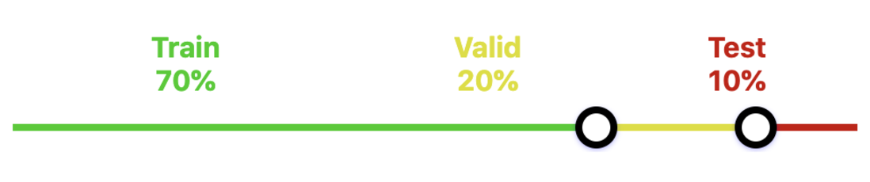
Data Preprocessing
2. YOLO Format Labels:
Labels are created using a full-frame bounding box.
Classes include AIRPLANE, BIRD, DRONE, and HELICOPTER.
3. Dataset Splitting:The extracted images are split into training (70%),
validation (20%), and test (10%) sets.
YOLO Label Format
Splitted Data

Slide 13
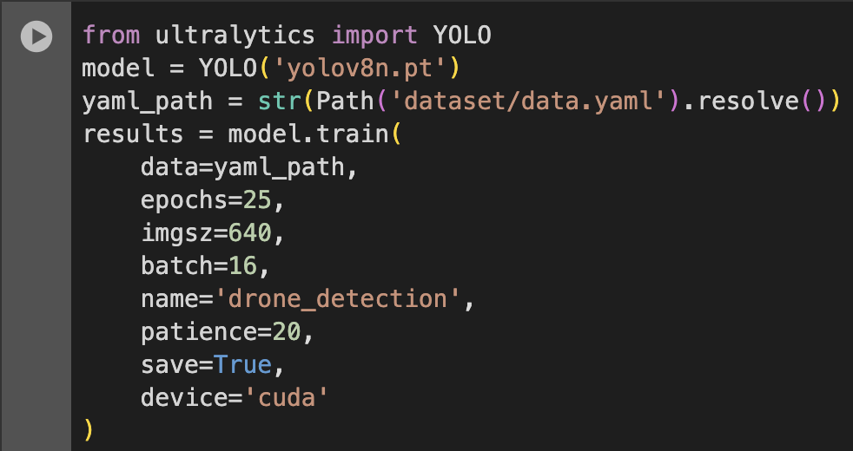
Model Training
Model Training with YOLO v8:
Pretrained Model:
YOLOv8 Nano (yolov8n.pt) is used for its balance of
speed and accuracy.
Training Parameters:
Input size: 640x640 pixels.
Batch size: 16 images per iteration.
Epochs: 25 for quick training.
Device: Trained using GPU (cuda) for efficiency.
Optimization: Utilizes Stochastic Gradient Descent (SGD) with a cosine learning rate scheduler to improve convergence.

Slide 14
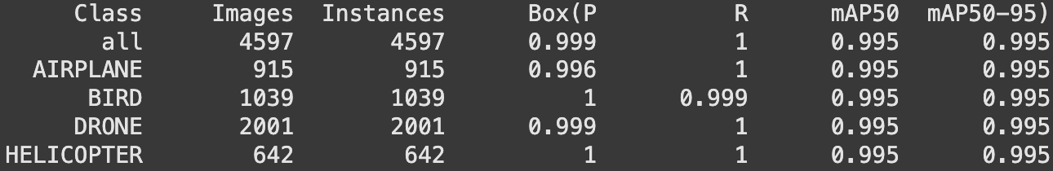

Evaluation Metrics
Evaluation of Model :
Key Metrics:
mAP50: Mean Average Precision at IoU = 0.5
mAP50-95: Mean Average Precision averaged across IoU thresholds [0.5, 0.95].
Results:
mAP50: 0.995
mAP50-95: 0.995
Deployment
Model Export: Exported to ONNX for deployment

Slide 15
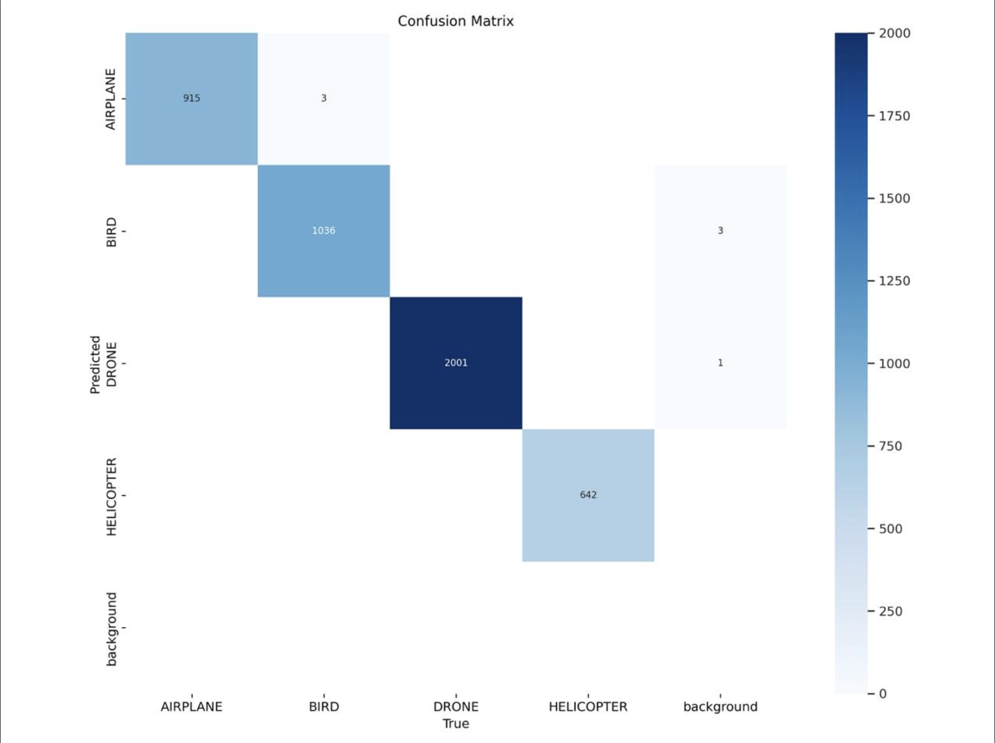
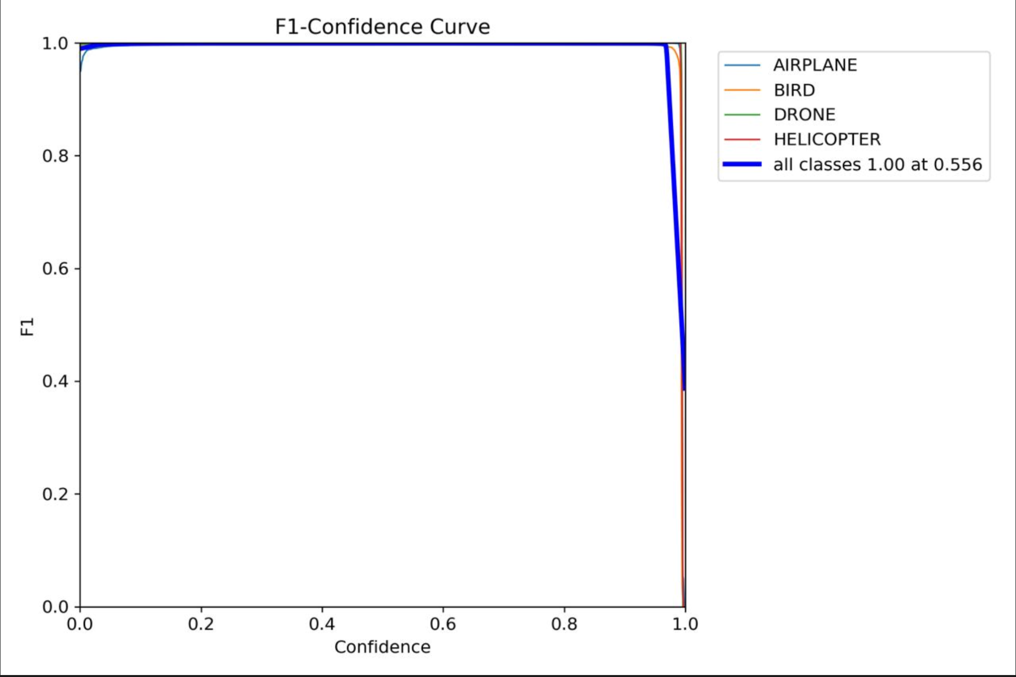
Model Evaluation Metrics
Confusion Matrix
F1-Confidence Matrix

Slide 16
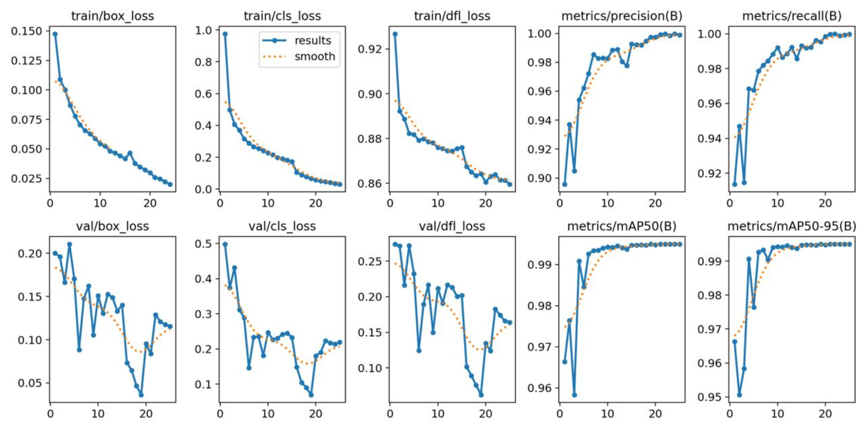
Trends per Epoch
Confusion Matrix
F1-Confidence Matrix

Slide 17
Case Study: Maha Kumbh Mela (Slide 13-15)
Large-scale gatherings like the Maha Kumbh Mela face threats from unauthorized drones.
Need for real-time detection in no-fly zones to ensure public safety.
Large noise due to dense population.
Temporary requirement of surveillance.
Climate conditions: Winter season (January-March)
Temperature range: 8°C to 25°C
Possible low visibility conditions
Hence, IR based image processing surveillance system will be most appropriate.

Slide 18
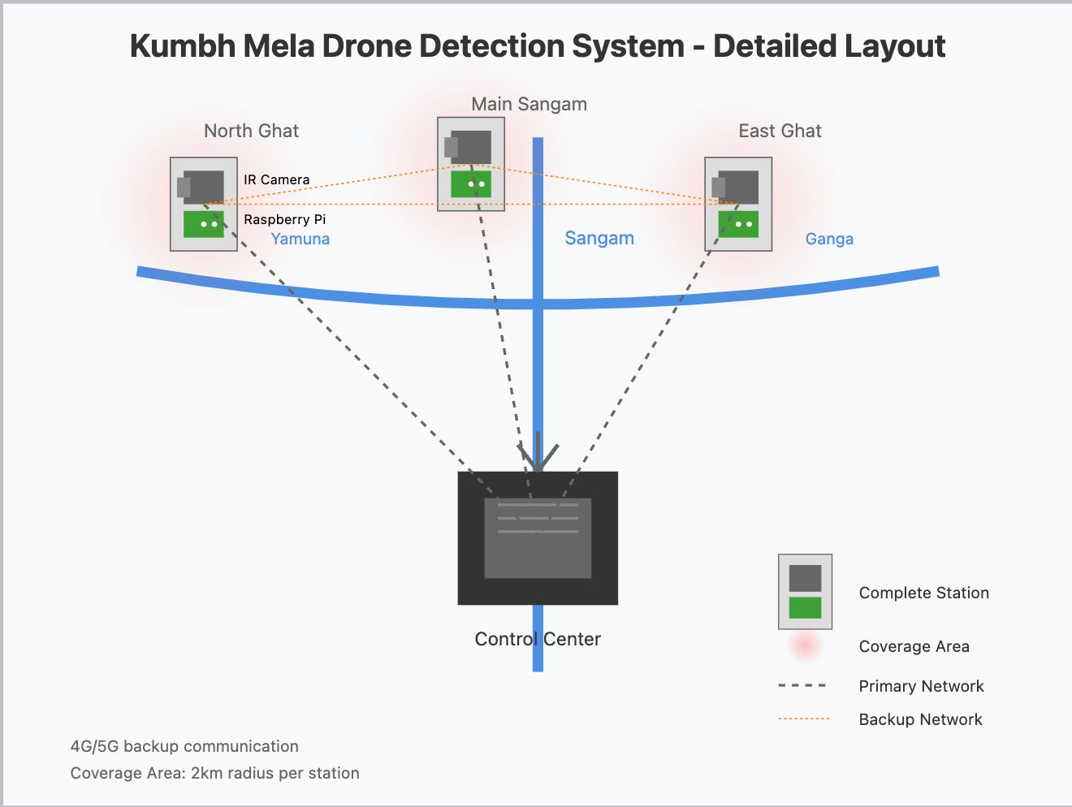
Maha Kumbh Mela Deployment Diagram
Confusion Matrix
F1-Confidence Matrix

Slide 19
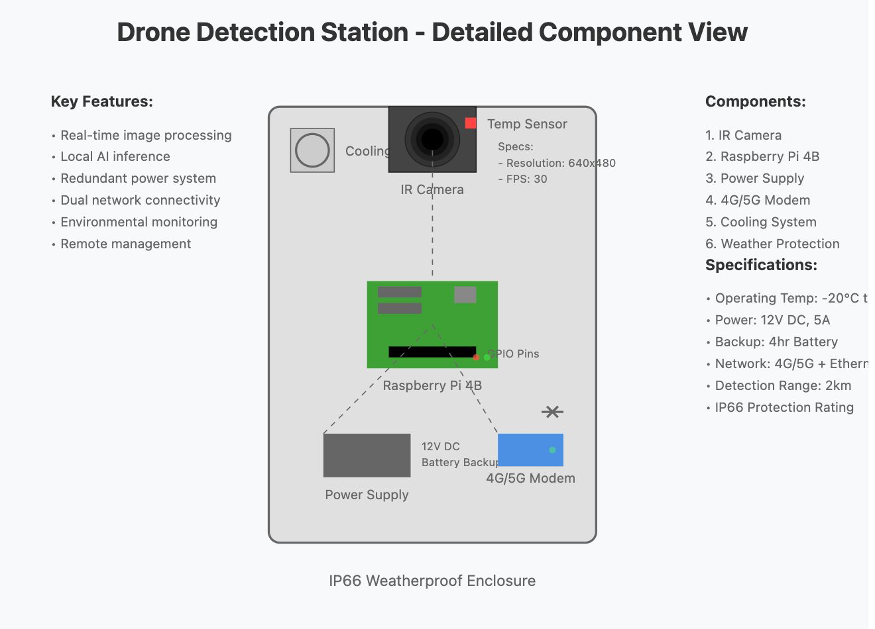
Individual Station

Slide 20
Future Scope
The following actions can be taken in order to increase the accuracy, scalability and ease of maintenance -
Deployment of Camera on Drone - as per proposed model, the camera is mounted on the ground, by deploying it on the drone, we can increase the coverage and decrease the number of drones. Also if confidence is less, drone can move closer to the object to detect it more precisely.
Cloud Computing for Drone Detection - instead of having the raspberry pi mounted with the camera we can integrate the camera to cloud.
AI based Trajectory Prediction and Multi-Object Tracking - Useful to predict the trajectory of the moving drone so that decisions can be taken according to the current location.
Integration of Camera taking Visual range images with IR camera - The accuracy of prediction will increase upon integrating both the images and then classifying them.

Slide 21

Thank you!

